Slide 1
RX Java Observables and Subscribers Part Deux
James.Fennell@lit.ie

Slide 2
Other Observable sources
We have looked at some factory methods that create observables:
Observable.create()
Observable.just()
Observable.fromIterable()
Now that we know more about Observers we can learn about a few more Observable factories

Slide 3
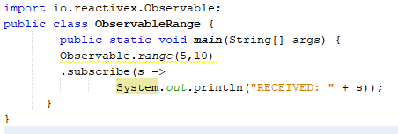

The Observable Observable.range()
Observable.range() emits a consecutive range of integers
It emits each number from a start value
incrementing each emission until the specified count is reached
These numbers are passed to the onNext() event, followed by the onComplete() event
It takes two arguments
The first arg is the starting value
The second arg is the total count of emissions
includes both the initial value and incremented values

Slide 4
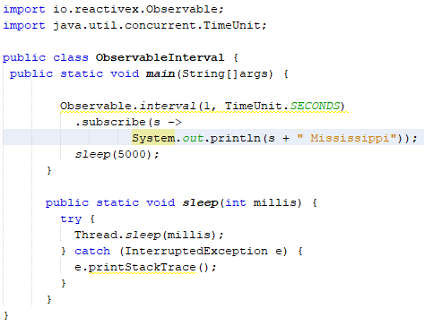

The Observable Observable.interval()
Observables emissions are handed from the source up to the Observer sequentially
Observable.interval() factory returns an Observable that will emit a consecutive long emission (starting at 0) at every specified time interval
See the Observable<Long> that emits every second

Slide 5
The Observable Observable.interval()
Observable.interval() will emit infinitely at the specified interval
As it operates on a timer, it needs to run on a separate thread
Note that our main() method is going to kick off this Observable
It won’t wait for it to finish
The Observable is emitting on a separate thread
we use a sleep() method to keep this application alive for five seconds
Otherwise the main() method will finish and exit the application before our Observable has fired

Slide 6
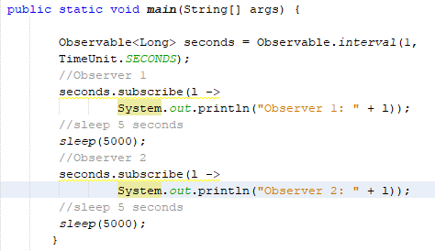
The Observable Observable.interval()
Does Observable.interval() return a hot or a cold Observable?
It is event-driven (and infinite), so you may be tempted to say it is hot
Test it!
put a second Observer on it, wait for five seconds
then add another Observer
What happens?

Slide 7
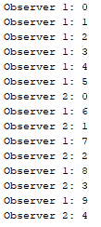
The Observable Observable.interval()
Observer 2 is on its own separate timer and starting at 0
These two observers are actually getting their own emissions, each starting at 0
The Observable.interval() is actually cold

Slide 8
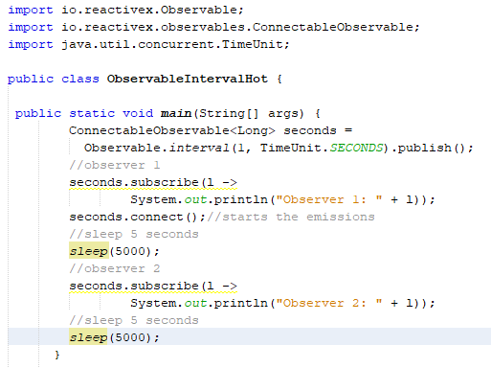
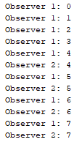
The Observable Observable.interval()
Use ConnectableObservable to force these emissions to become hot
To put all observers on the same timer with the same emissions
Now Observer 2 will be in sync with Observer 1 receiving the same emissions
Despite being 5 seconds late and having missed the previous emissions

Slide 9
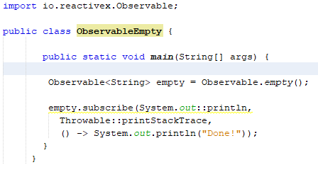
The Observable Observable.empty()
Sometimes you need an Observable that emits nothing and calls onComplete()
They can:
represent empty datasets
result from operators such as filter()
An empty Observable is essentially RxJava's concept of null
It is the absence of a value
They avoid throwing NullPointerExceptions

Slide 10
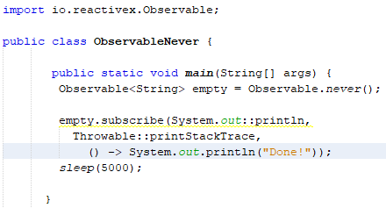
The Observable Observable.never()
Observable.never() is related to Observable.empty()
The difference is that it never calls onComplete()
forever leaving observers waiting for emissions but never giving any
It is primarily used for testing and not that often in production
We have to use sleep() here to prove that no emissions are coming from it

Slide 11
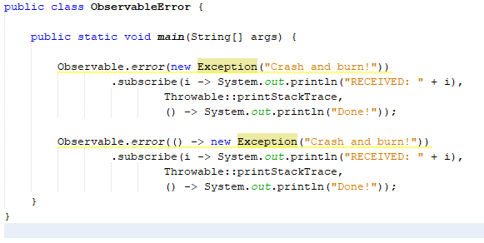
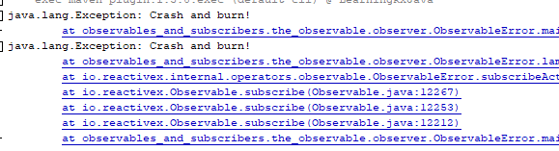
The Observable Observable.error()
Observable.error() is another Observable that is useful for testing
You can create an Observable that immediately calls onError() with a specified exception
You can also provide the exception through a lambda

Slide 12
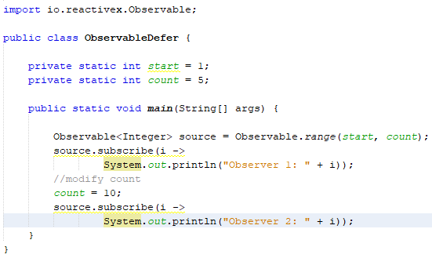
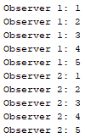
The Observable Observable.defer()
Observable.defer() can create a separate state for each Observer
Other source Observables may not catch state changes and send emissions that are obsolete
Here we have an Observable.range() built off two static int properties, start and count
If you subscribe to this Observable, modify the count, and subscribe again, you will find that the second Observer does not see this change

Slide 13
The Observable Observable.defer()
Creating a fresh Observable for each subscription avoids this problem
We us Observable.defer() to do this
This accepts a lambda instructing how to create an Observable for every subscription
By creating a new Observable each time changes to parameters are captured

Slide 14
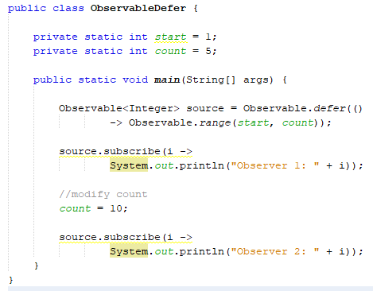
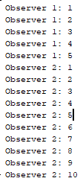
The Observable Observable.defer()
Deferring creation of the Observable until subscription avoids this problem
We us Observable.defer() to do this
This accepts a lambda instructing how to create an Observable for every subscription
By creating a new Observable each time changes to parameters are captured

Slide 15
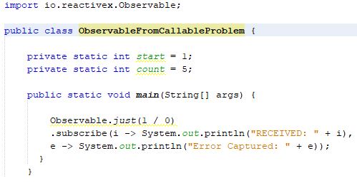
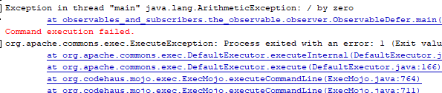
The Observable Observable.fromCallable()
If you need to perform a calculation or action and then emit it, you can use Observable.just()
sometimes, we want to do this in a lazy or deferred manner
If that procedure throws an error it should be emitted up the Observable chain through onError()
rather than throw the error at that location in traditional Java fashion
E.g. - Wrapping Observable.just() around an expression that divides 1 by 0
the exception will be thrown
not emitted up to Observer

Slide 16
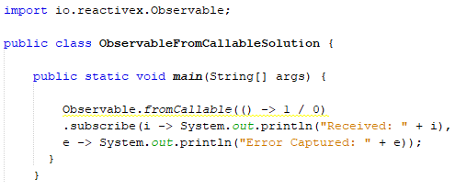
The Observable Observable.fromCallable()
To be reactive in our error handling this is not desirable
To emit the error down the chain to the Observer where it will be handled use Observable.fromCallable()
It takes a lambda Supplier<T> which will emit any error down to Observer
If initializing your emission can throw an error use Observable.fromCallable() instead of Observable.just()

Slide 17
The Observable
There are a specific set of Observables set up for one or no emissions:
Single
Maybe
Completable
These all follow the Observable closely and should be intuitive to use in your reactive coding workflow
You can create them in similar ways as the Observable (for example, they each have their own create() factory)
Certain Observable operators may return them as well

Slide 18
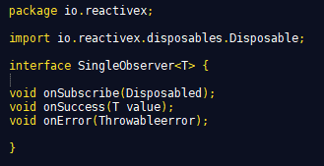
The Observable Single
Single<T> is an Observable<T> that will only emit one item
It works just like an Observable,
is limited only to operators that make sense for a single emission
It has its own SingleObserver interface as well

Slide 19
The Observable Single
Single<T> is an Observable<T> that will only emit one item
It works just like an Observable,
is limited only to operators that make sense for a single emission
It has its own SingleObserver interface as well
onSuccess() consolidates onNext() and onComplete() into a single event that accepts the one emission

Slide 20
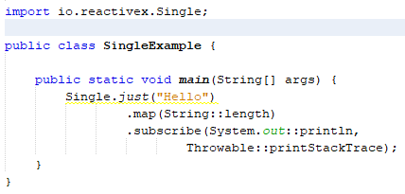
The Observable Single
When you call subscribe() against a Single, you provide the lambdas for onSuccess() as well as an optional onError()

Slide 21
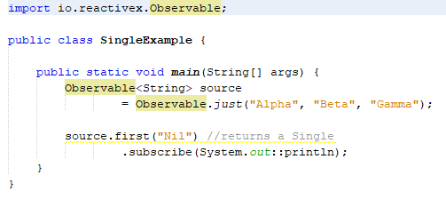
The Observable Single
Some RxJava Observable operators will yield a Single
the first() operator will return a Single since that operator is logically concerned with a single item
It accepts a default value as a parameter in case the Observable comes out empty

Slide 22
The Observable Single
The Single must have one emission, and you should prefer it if you only have one emission to provide
This means that instead of using Observable.just("Alpha")
use Single.just("Alpha") instead
There are operators on Single that will allow you to turn it into an Observable when needed, such as toObservable()
If there are 0 or 1 emissions, you will want to use Maybe.

Slide 23
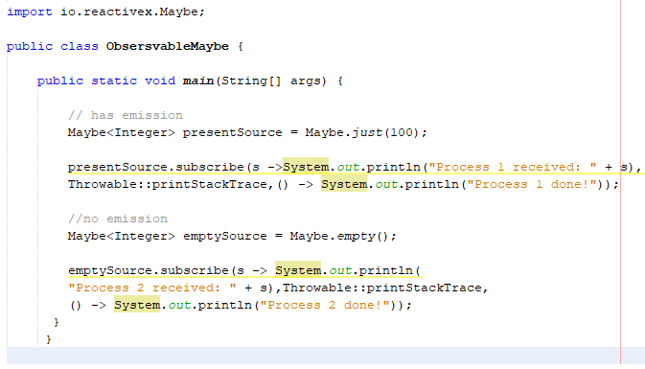

The Observable Maybe
Maybe is just like a Single except that it allows no emission to occur at all
MaybeObserver is like a standard Observer, but onNext() is called onSuccess() instead
A given Maybe<T> will only emit 0 or 1 emissions
It will pass the possible emission to onSuccess()
Otherwise it calls onComplete() when done
Maybe.just() can be used to create a Maybe emitting the single item
Maybe.empty() will create a Maybe that yields no emission

Slide 24
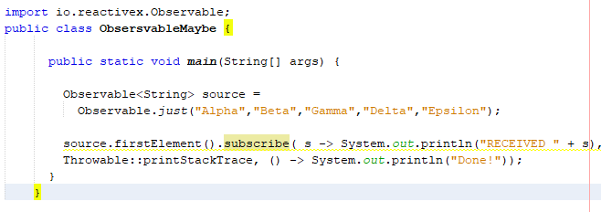
The Observable Maybe
Certain Observable operators that return a Maybe
One example is the firstElement() operator
It is similar to first(), but it returns an empty result if no elements are emitted

Slide 25
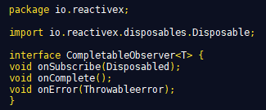
The Observable Completable
Completable is concerned with an action being executed
it does not receive any emissions
It does not have onNext() or onSuccess() to receive emissions
It does have onError() and onComplete()

Slide 26
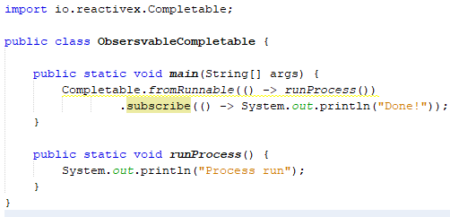

The Observable Completable
Completable is not used often
You can construct one quickly by calling
Completable.complete()
will immediately call onComplete() without doing anything
Completable.fromRunnable()
will execute the specified action before calling onComplete()

Slide 27
The Observable Disposing
When you subscribe() to an Observable a stream is used to process emissions
When finished we dispose of the created resources (let them be garbage-collected)
Observables that call onComplete() will dispose of themselves safely when they are done
Consider infinite/long-running Observables
you need to explicitly stop the emissions
dispose of everything associated with that subscription

Slide 28

The Observable Disposing
The garbage collector won’t remove active subscriptions you don’t need
explicit disposal is necessary in order to prevent memory leaks
The Disposable is a link between an Observable and an active Observer
call its dispose() method to stop emissions and dispose of resources the Observer used
There is also a isDisposed() method
returns a Boolean: true if disposed of already

Slide 29
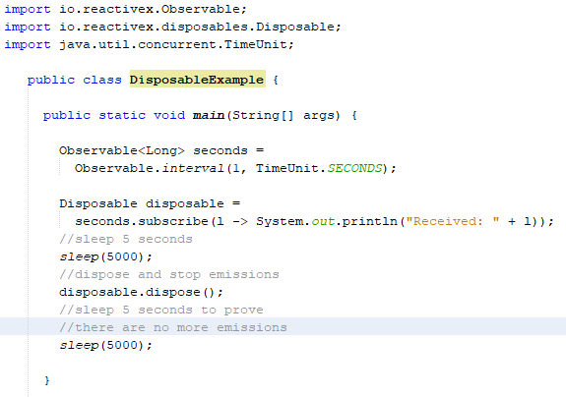
The Observable Disposing
Provide onNext(), onComplete(), and/or onError() lambdas as arguments to the subscribe() method
It will return a Disposable
You can use this to stop emissions at any time by calling its dispose() method
We let Observable.interval() run for five seconds with an Observer
We save the Disposable returned from the subscribe() method
Then we call the Disposable's dispose() method to stop the process and free any resources that were being used
Then we sleep for another five seconds to show no more emissions occur

Slide 30
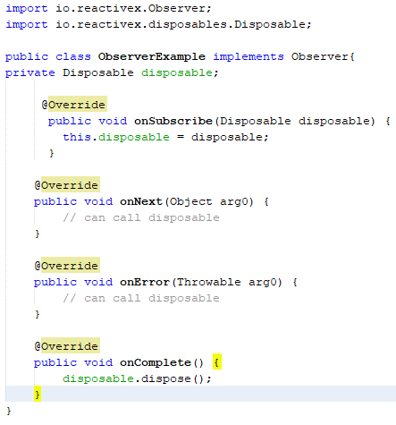
The Observable Disposing
A Disposable is passed in the implementation of an Observer through the onSubscribe() method
It allows the Observer to have the ability to dispose of the subscription at any time
When implementing your own Observer onNext(), onComplete(), or onError() can now have access to the Disposable
Now these three events can call dispose() if the Observer does not want any more emissions

Slide 31
The Observable Disposing in the Observer
Provide onNext(), onComplete(), and/or onError() lambdas as arguments to the subscribe() method
It will return a Disposable
You can use this to stop emissions at any time by calling its dispose() method
We let Observable.interval() run for five seconds with an Observer
We save the Disposable returned from the subscribe() method
Then we call the Disposable's dispose() method to stop the process and free any resources that were being used
Then we sleep for another five seconds to show no more emissions occur

Slide 32
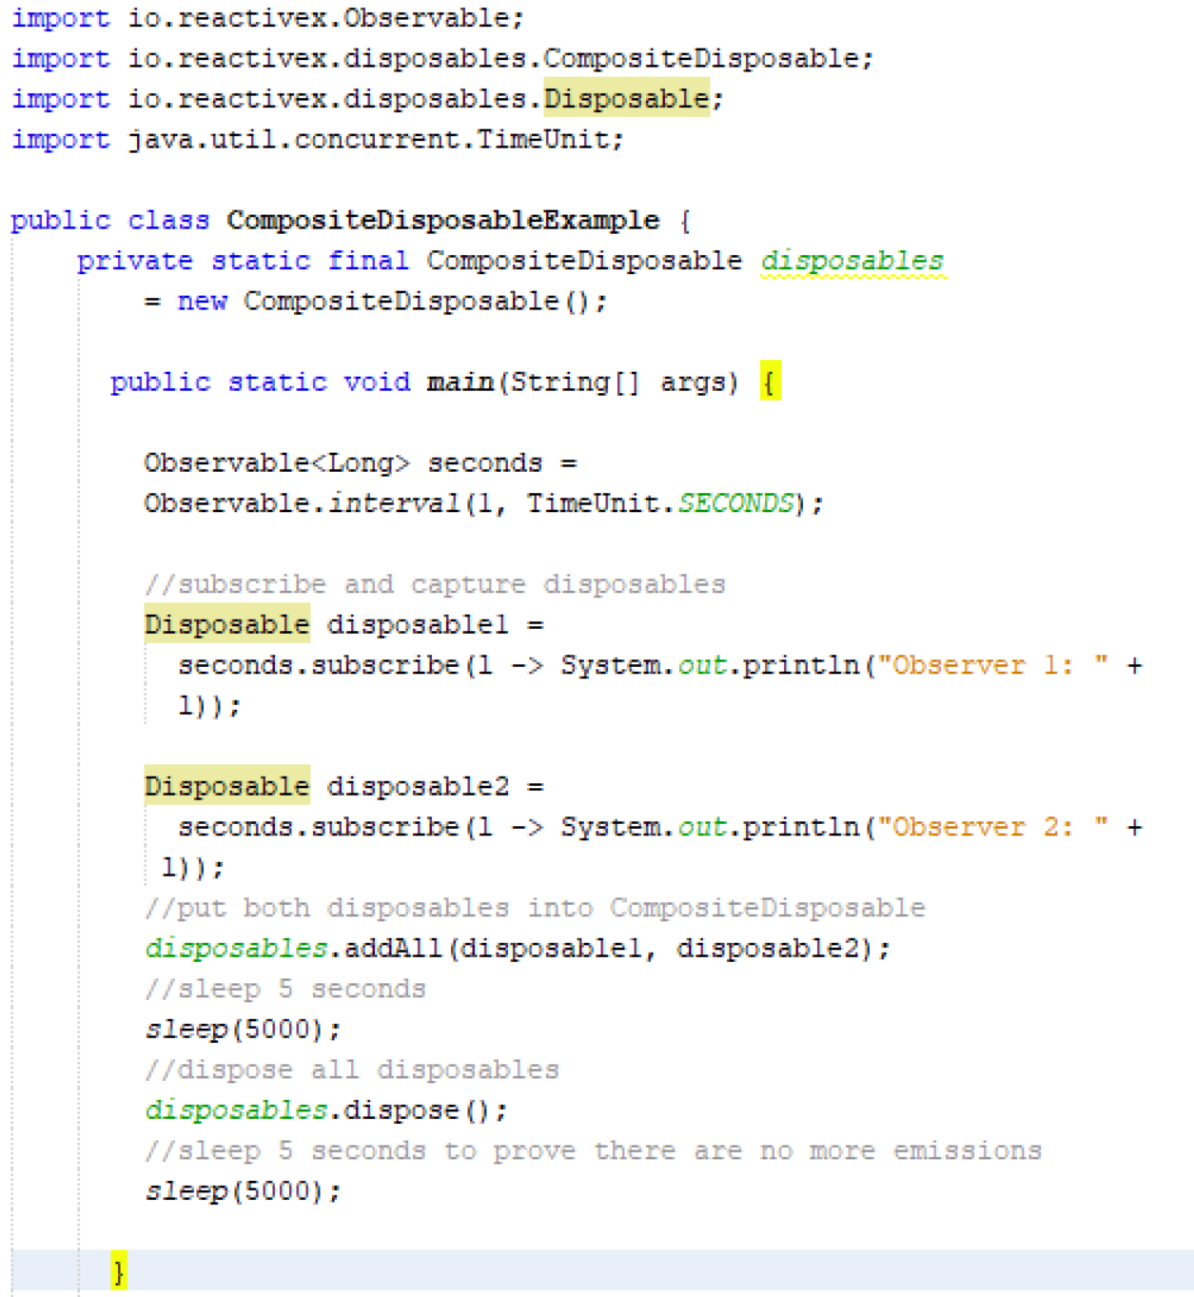
The Observable Composite Disposable
CompositeDisposable is used to manage multiple subscriptions
It implements Disposable
internally it holds a collection of disposables, which you can add to
You can then dispose all of them at once
you can add to by calling add() or addAll()
When appropriate you can call dispose() to dispose of all of them

